Slide 1
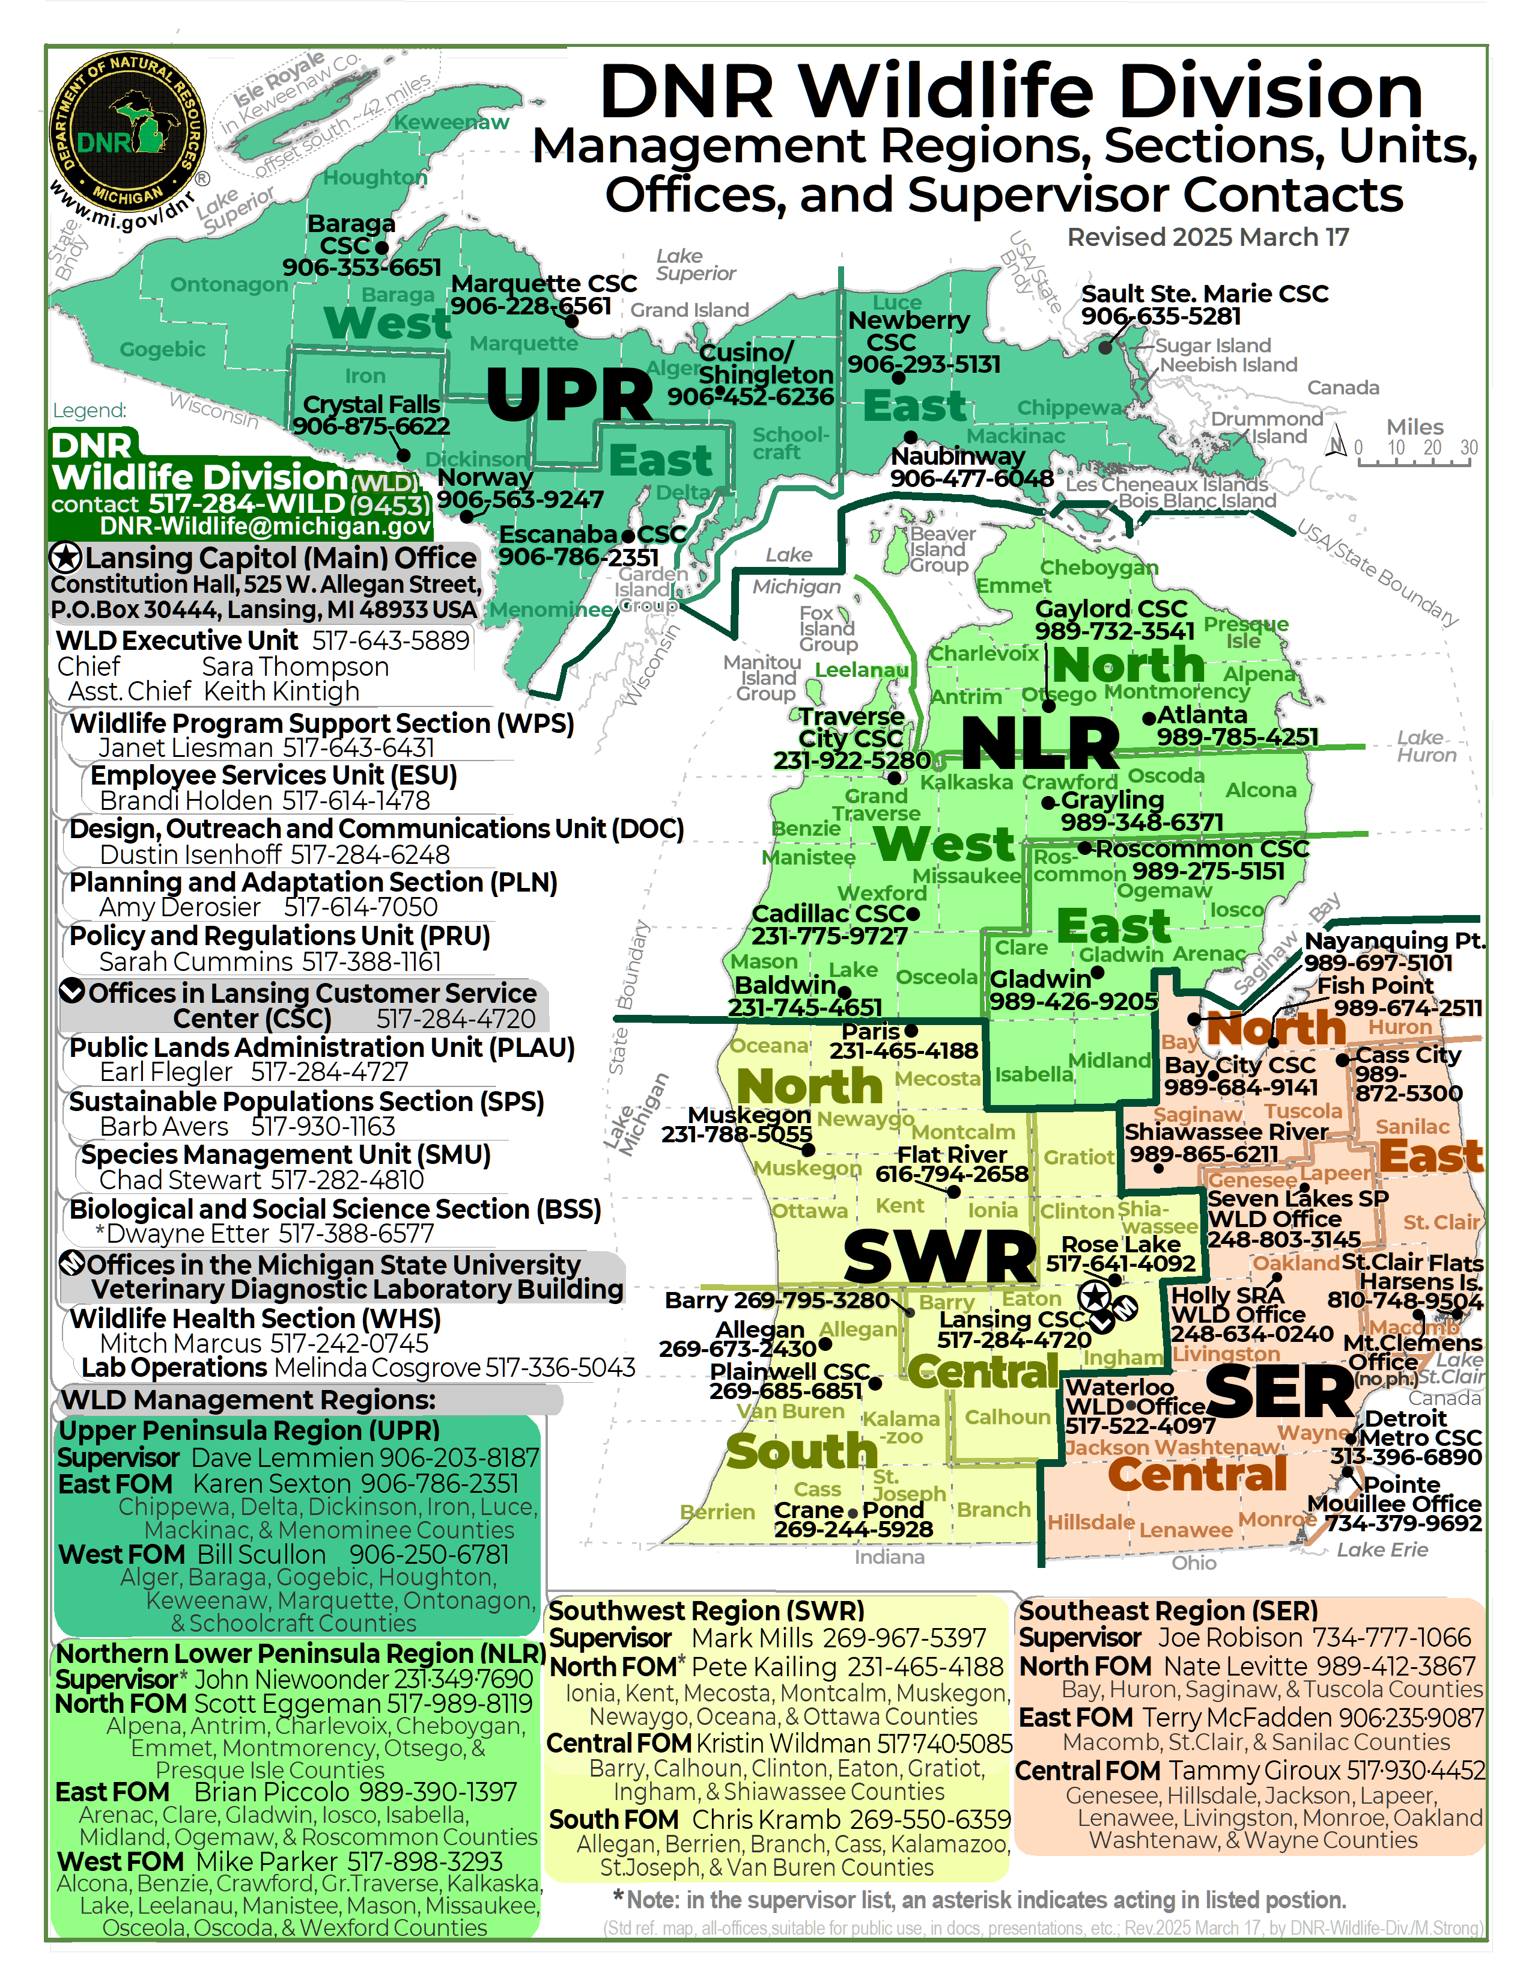

Slide 2
2025 March 17 update (prev slide)
DNR WLD R/S/U’s & offices map with FOM sub-splits (confirmed)
… & other similar alt map versions
What follows is simpler versions of the standard template with phone numbers and names
You can copy from these slides and insert image JPG file into a document. There is space at bottom for Figure number and caption, if needed. If an appendice, then slide the graphic down and put Appendice number and title at the top.

Slide 3
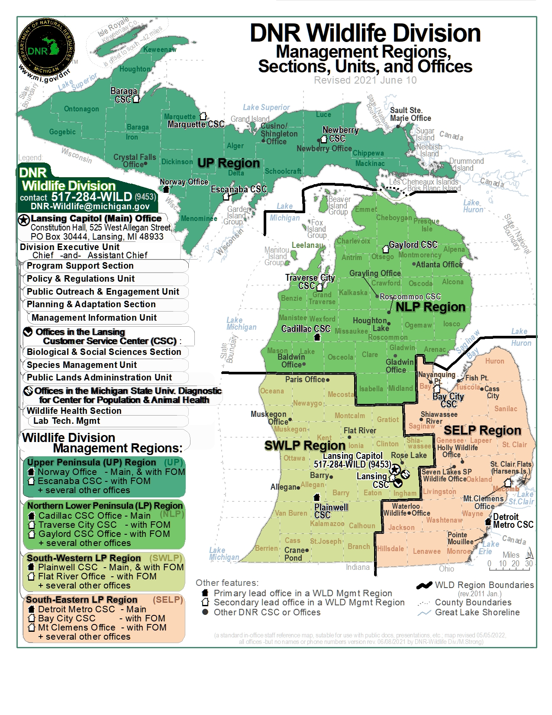

Slide 4
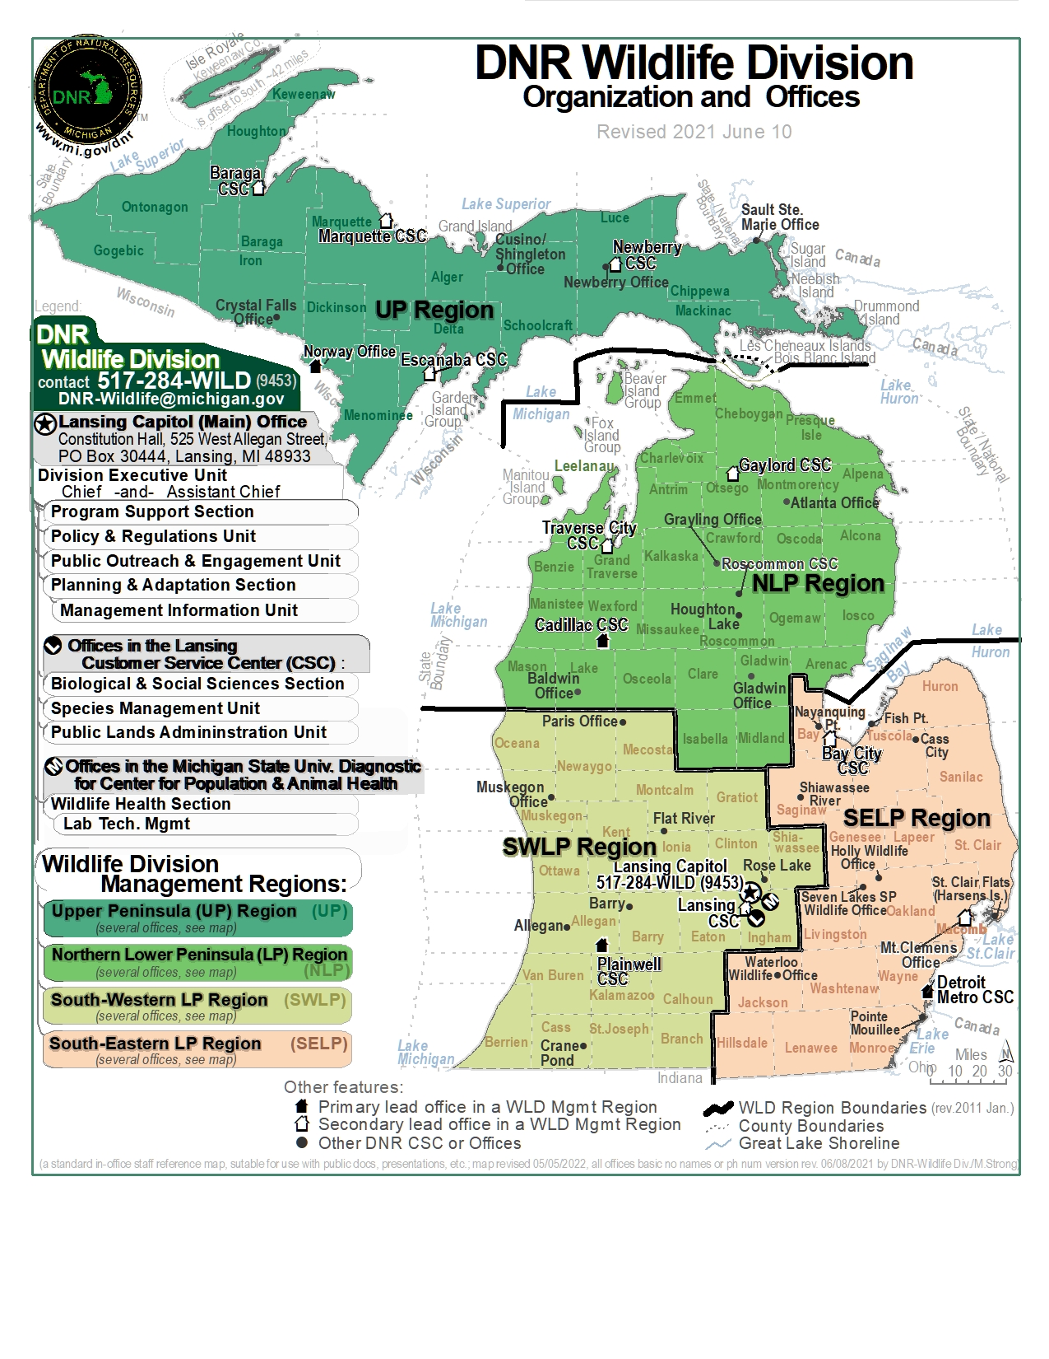

Slide 5
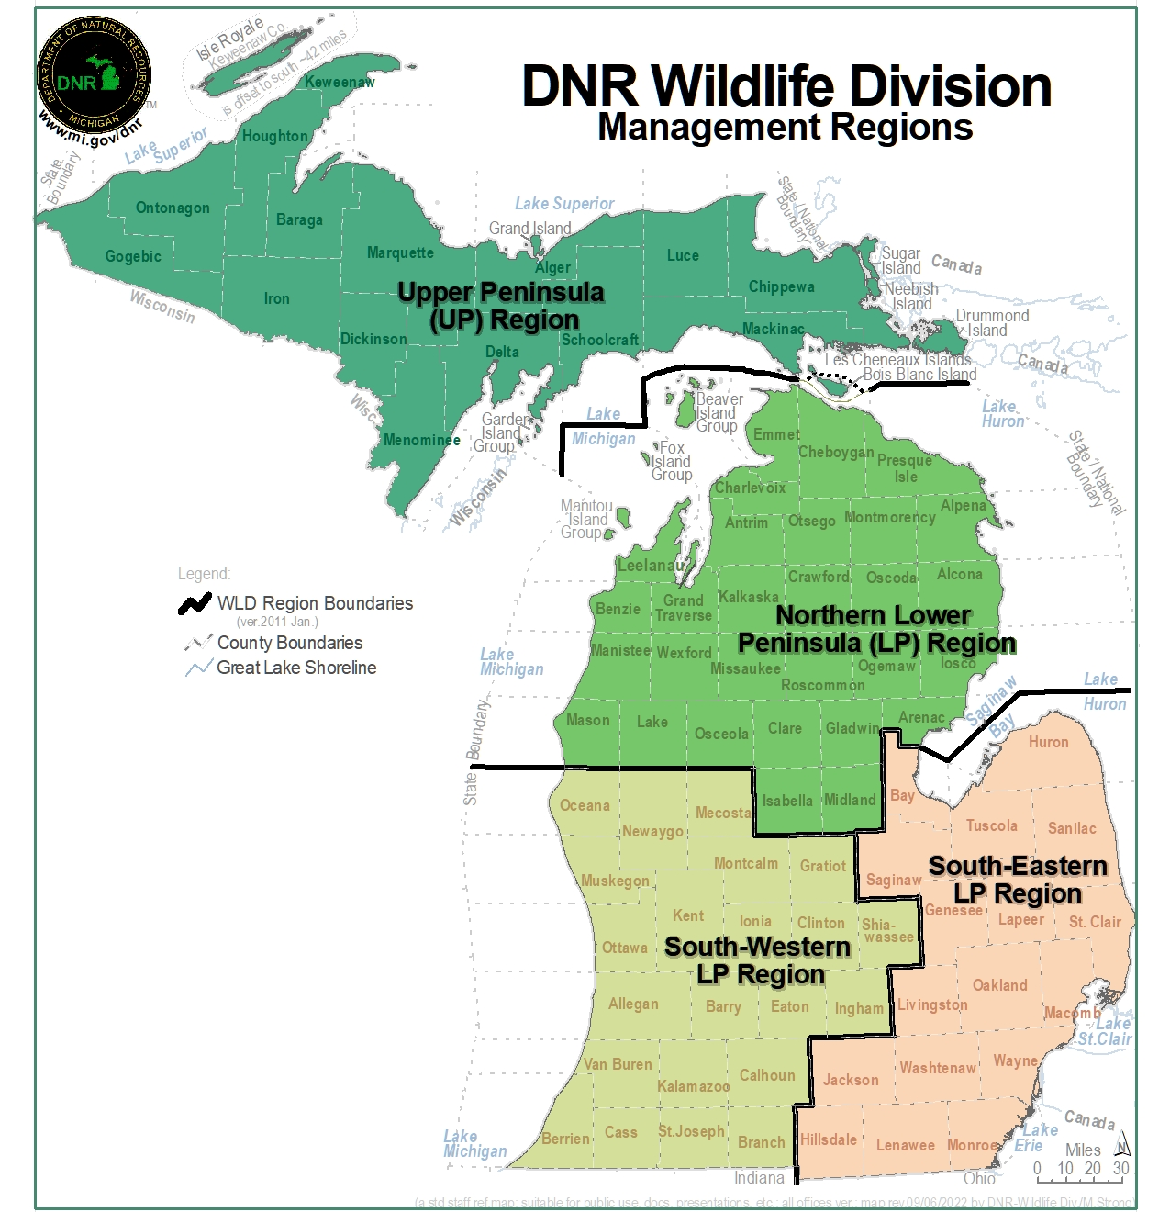

Slide 6
